Slide 1

Job Portal & Placement Site
Administrator Module
Project Team
Project Supervisor:
Prof. Dr. V. Siva Rama
Krishniah
Siddharth Karmokar
Rushikesh Iche
Gaurav Singh
Rineet Pandey

Slide 2



Introduction: The Problem
The traditional campus placement process remains fundamentally manual, creating significant operational challenges that impact both efficiency and accuracy.
Time – Intensive
Verification
Fragmented Data
Error-Prone
Operations
Critical information is scattered across multiple spreadsheets, email threads, and physical documents with no single source of truth.
Coordinators manually verify student eligibility criteria for each company, consuming valuable hours that could be spent on strategic activities.
Manual data entry and processing creates operational bottlenecks and increases the risk of costly human errors in student placements.

Slide 3
Our Solution: Core Objectives
This administrator-side system transforms placement operations through intelligent automation, centralized data management, and powerful administrative tools designed to eliminate inefficiencies.
01
02
03
Centralize Student Data
Automate Manual Tasks
Streamline Job Posting
Establish a unified repository consolidating all student profiles, academic records, and placement preferences into one secure, accessible location.
Eliminate repetitive work by automating account initialization workflows and eligibility verification processes based on predefined criteria.
Enable efficient job opportunity creation with seamless Google Form integration for application collection and automated distribution.
04
05
Provide Master Sheet
Ensure Data Integrity
Deliver comprehensive analytics through a single master sheet that logs all company interactions and tracks student application statuses in real-time.
Implement admin-controlled profile modification protocols after initial student edits to maintain data accuracy and prevent unauthorized changes.

Slide 4
Technology Stack
A carefully selected, high-performance technology ecosystem engineered for scalability, security,
and optimal user experience.
1
2
3
Frontend Framework
Backend API
Database System
ReactJS with Tailwind CSS for responsive, component-based UI development
FastAPI (Python) delivering high-speed, asynchronous request handling
MongoDB providing flexible, document-based data storage
Authentication
Integration
Version Control
JWT-based secure login system with token refresh mechanisms
Google APIs (Sheets & Forms) for seamless data synchronization
GitHub for collaborative development and code management

Slide 5


Deployment Architecture
A sophisticated hybrid cloud infrastructure designed for reliability, performance, and seamless scalability across global user bases.
Frontend Layer
Backend Layer
Security & Scale
Deployed on Vercel with global CDN distribution and automated build pipelines for instant updates
Hosted on AWS EC2 with Dockerized FastAPI server and Nginx reverse proxy configuration
HTTPS via AWS Certificate Manager with Elastic Load Balancer and Auto-Scaling Groups for dynamic capacity management
Production-Ready Infrastructure: This deployment architecture ensures 99.9% uptime, automatic failover capabilities, and horizontal scaling to handle peak placement season traffic.

Slide 6
Core Admin Modules
The Administrator Module is built on three foundational pillars that work together to create a seamless placement management experience.
1
2
3
Student Management Module
Job Posting & Google Form Automation
Master Data Sheet Module
Real-time application tracking via automated Google Sheets integration
Centralized control over student profiles, credentials, and data integrity
Automated job distribution with intelligent eligibility filtering

Slide 7
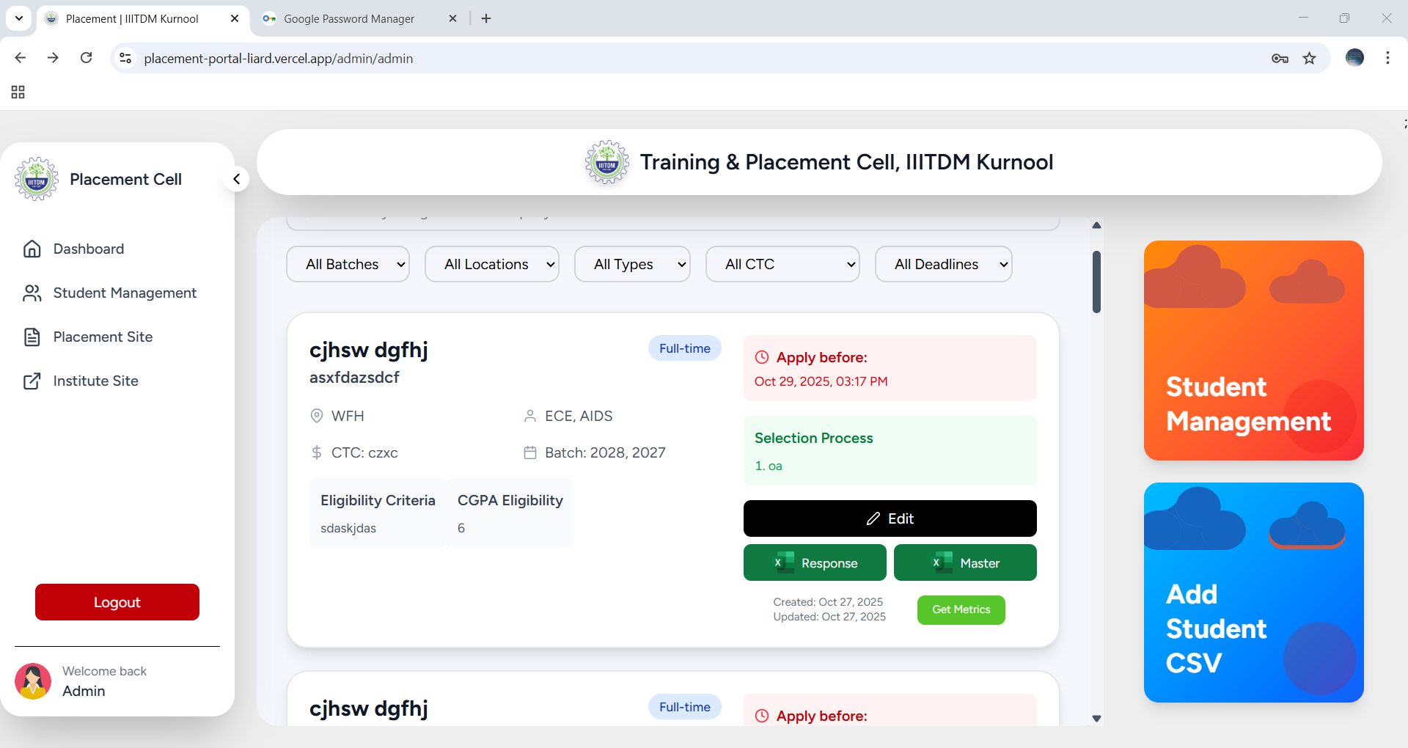
Admin Dashboard Overview

Slide 8
Module 1: Student Management
This module provides comprehensive administrative control over student data throughout
the entire placement lifecycle.
Initial Database Import
Account Initialization
Bulk-create student accounts efficiently via CSV upload. Import hundreds of student records in seconds.
System automatically generates secure credentials and sends personalized welcome emails to each student.
Profile Data Control
Admin Override Access
Students can edit their profile once to ensure accuracy. After initial setup, all changes require admin approval to maintain data integrity.
Administrators maintain full access to directly modify any student profile when necessary, ensuring complete control.

Slide 9
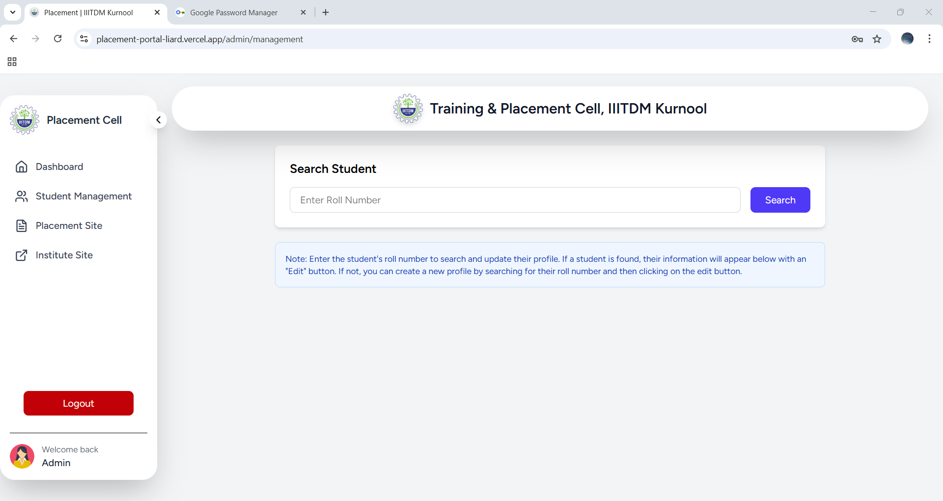
MODULE-1
Student Management

Slide 10

Module 2: Job Posting & Google Form Automation
Streamlines the creation of new job opportunities while ensuring only qualified students see relevant postings.
Job Creation
Admin defines job descriptions, eligibility criteria including CGPA thresholds, backlog limits, and branch requirements.
Google Form Integration
Admin links application forms. The system automatically displays opportunities only to eligible students based on their profiles.

Slide 11
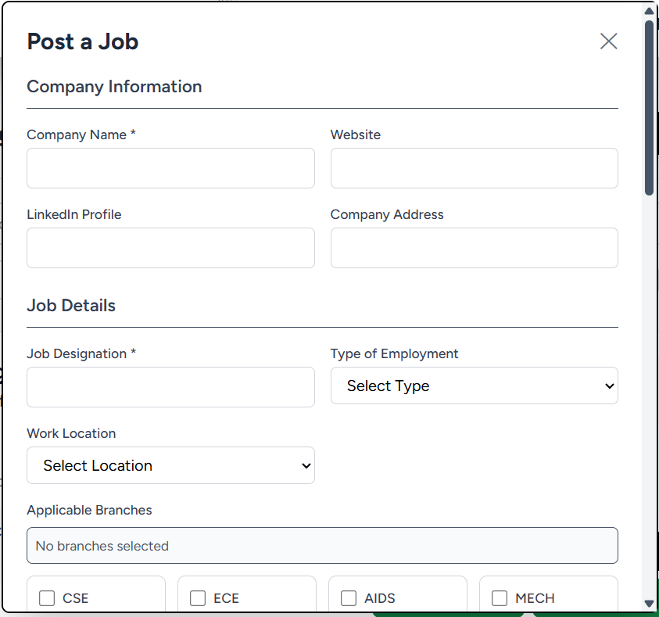
Module 2
Sample Form Overview

Slide 12
Module 3: Master Data Sheet
The primary reporting and tracking feature, powered by the Google Sheets API, provides unprecedented visibility into the placement process.
1
2
3
Master Sheet Generation
2D Matrix Structure
Automated Data Logging
The system automatically generates a comprehensive "Master Placement Data Sheet" that serves as the single source of truth.
Rows represent students (Roll Number/Name), columns represent companies/jobs, and cells auto-update with "Applied" status.
Provides a complete, at-a-glance view of all applications for the entire batch with zero manual data entry.

Slide 13
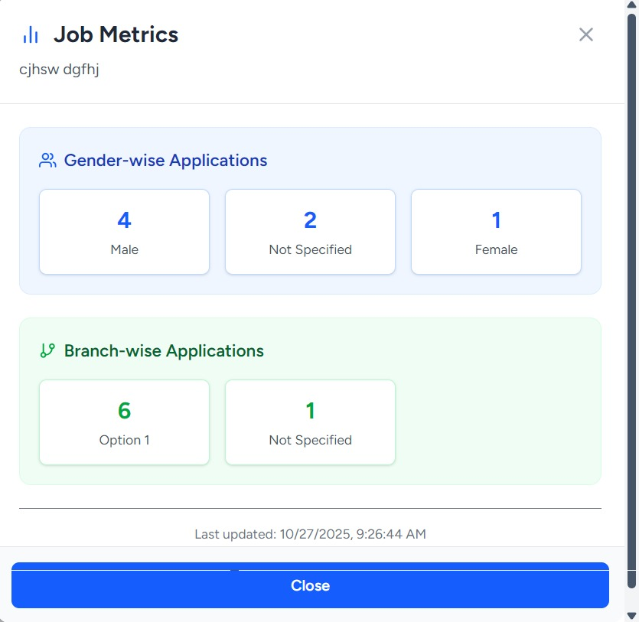
Module 3 Overview
A collective data view to master data sheet

Slide 14
System Inputs & Queries
System Inputs
Queries Handled
Advanced Filtering
Student Data (CSV)
Filter students by branch, CGPA threshold, or backlog status for targeted job matching
Bulk upload of student records with profile information
Manual Data Edits
Student Lookup
Quickly locate specific students to perform manual
profile edits
Admin-initiated profile updates and corrections
Application Reports
Job Posting Details
Generate lists of all students who applied for specific
job postings
Company information, requirements, and application forms
Master Data Retrieval
Access comprehensive data for the Master Placement
Data Sheet

Slide 15
System Outputs
Profile Management Interface
Job Card Dashboard
Automated Credential Emails
Master Placement Data Sheet
Intuitive search, filter, and edit capabilities for managing student records efficiently
Visual display of active and archived job postings with quick access controls
System-generated welcome messages with login credentials sent to students
Updating 2D matrix showing complete application tracking across all students and companies

Slide 16
Security & Performance Testing
Security Features
User Testing Results
JWT Tokens
30
Secure authentication with industry-standard JSON Web Tokens
Student Testers
Bcrypt Password Hashing
Real-world validation with diverse user group
Military-grade encryption protects all user credentials
"Interface is smooth, intuitive, and clear. Navigation feels natural and everything works as expected."
Role-Based Access Control
RBAC ensures users only access appropriate system features
HTTPS Communication
All data transmission encrypted end-to-end
Input Sanitization
Protection against SQL injection and XSS attacks

Slide 17
Stress Test Results
Validation of system performance under heavy load using Locust
500
183.6
1%
140ms
Concurrent Users
Requests Per Second
Failure Rate
Median Response Time
Simulated peak load conditions
Average RPS sustained throughout test
Exceptional reliability under stress
Lightning-fast user experience
These results demonstrate that the system can comfortably handle large-scale deployment across multiple departments and campuses simultaneously.

Slide 18




Stakeholder Benefits
Placement Coordinators
Recruiters
Institution
Eliminates manual eligibility verification saving hours daily
Receive pre-verified, high-quality candidate data instantly
Improved reputation with modern, efficient placement process
Reduces administrative overhead by up to 70%
Streamlined communication through single point of contact
Scalable architecture grows with institutional needs
Analytics-driven decisions from real-time reports and insights
Faster hiring process with qualified applicants only
Enhanced data security and compliance

Slide 19
Transforming Placement Management
The Administrator Module transforms the manual placement process into a secure, automated, and data-driven system that benefits all stakeholders.
Integrated Solution
Proven Reliability
Ready for Scale
Student management, Google Form automation, and Master Data Sheet work seamlessly together
Stress tested at 183.6 RPS with 500 concurrent users and only 1% failure rate
Built on modern architecture designed to grow with your institution's needs
This system empowers placement coordinators to focus on strategic initiatives rather than manual data management, ultimately leading to better outcomes for students and stronger relationships with recruiting companies.

